Slide 1
IPL SCORE AND WINNER PREDICTOR
CAPSTONE PROJECT
Presented By:
1. Anjali Rakesh Yadav –Shri vile parle kelvani mandal institute of technology Dhule - Electrical

Slide 2
OUTLINE
Problem Statement (Should not include solution)
Proposed System/Solution
System Development Approach (Technology Used)
Result
Conclusion
Future Scope
References

Slide 3
Problem Statement
Create a IPL score and winner predictor Predicting the scores and the winner of IPL matches is a challenging task due to the complexity of the game and various factors that can affect the outcome of a match. The problem we aim to solve with the implementation of a web portal using machine learning for IPL score and winner prediction is the challenge of accurate predicting the outcome of IPL matches. Predicting the scores and winners of cricket matches is a complex task that requires the analysis of various factors such as play form, playing conditions, and team strategies. The web portal will use machine learning models trained on historical IPL data to provide accurate predictions of scores and winners for upcoming matches. This will enhance the viewing experience of cricket fans by providing them with insightful predictions that they can use to follow the matches with a greater understanding of the game. In summary, the implementation of the web portal using machine learning for IPL score and winner prediction aims to improve the accuracy of predictions for IPL matches and enhance the experience of cricket fans and professionals.

Slide 4
Proposed Solution
Preprocess and clean the IPL historical data to create a dataset suitable for machine learning
Develop and train machine learning models using various algorithms such as regression and classification to predict the scores and winners of IPL matches.
Evaluate the performance of the machine learning models using various metric such as accuracy RMSE, MAE.
Develop a web portal that can display predictions of IPL match scores and winners based on the trained machine learning models.
Deploy the web portal on a cloud-based platform to make it accessible to cricket fans, team owners, coaches, and sports analysts.
Continuously update the machine learning models with the latest IPL data to improve the accuracy of the predictions. By achieving these objectives, we aim to provide an accurate and reliable IPL score and winner prediction web portal that can be used by cricket fans and professionals to enhance their viewing experience and make informed decisions.

Slide 5
System Approach
The Hardware and Software Requirements
Hardware Requirements:
There are no specific hardware requirements.
Software Requirements:
● Jupyter Notebook
● Visual Studio Code
● Flask 2.2.3
● Python 3.10.6
● Scikit-learn 1.2.2
● Pandas 1.5.3
● Numpy1.24.2
● Seaborn 0.12.2
For more information refer to requirements.txt file

Slide 6
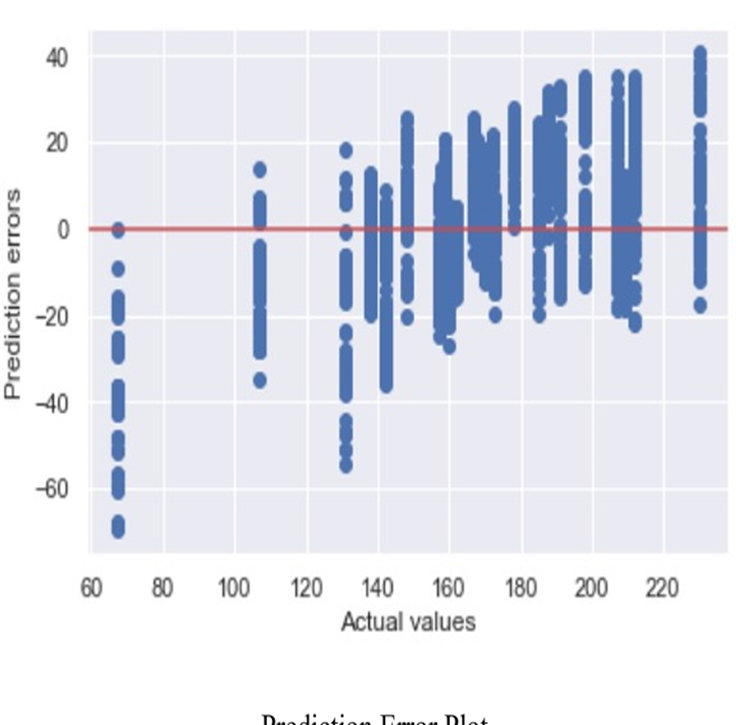
Result
A Our model achieved a mean absolute error of 12.118617546193295 and a root mean squared error of 15.8432295667321 when predicting the target variable for ipl.csv dataset using linear regression algorithm. The accuracy achieved for matches.csv dataset was 89.47% using random forest classifier. These results indicate that our model performed well in predicting the target variable.ipl.csv: Prediction of target score

Slide 7
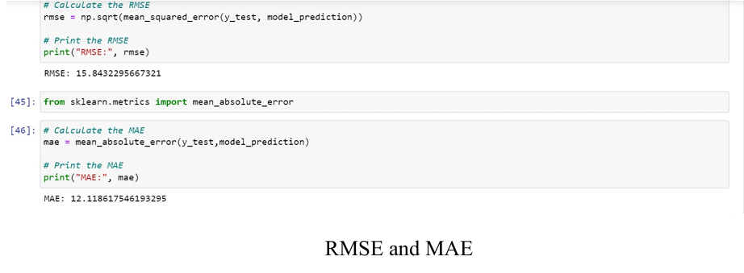
Result

Slide 8
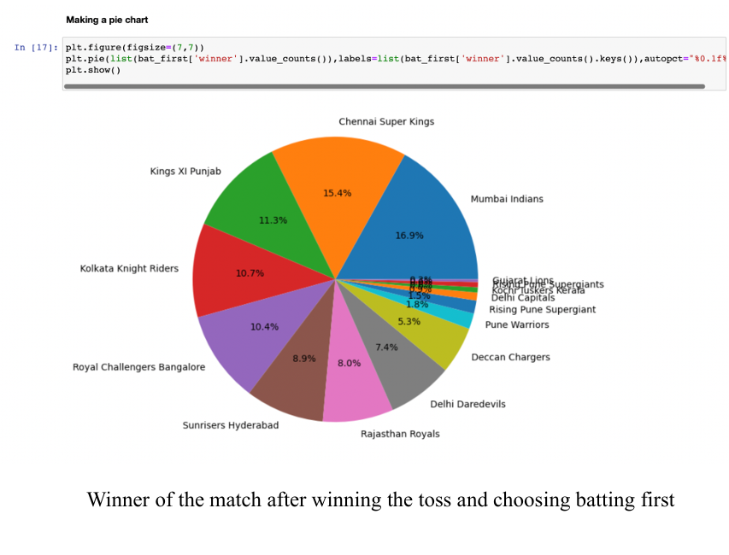
matches.csv: Winner of the match

Slide 9
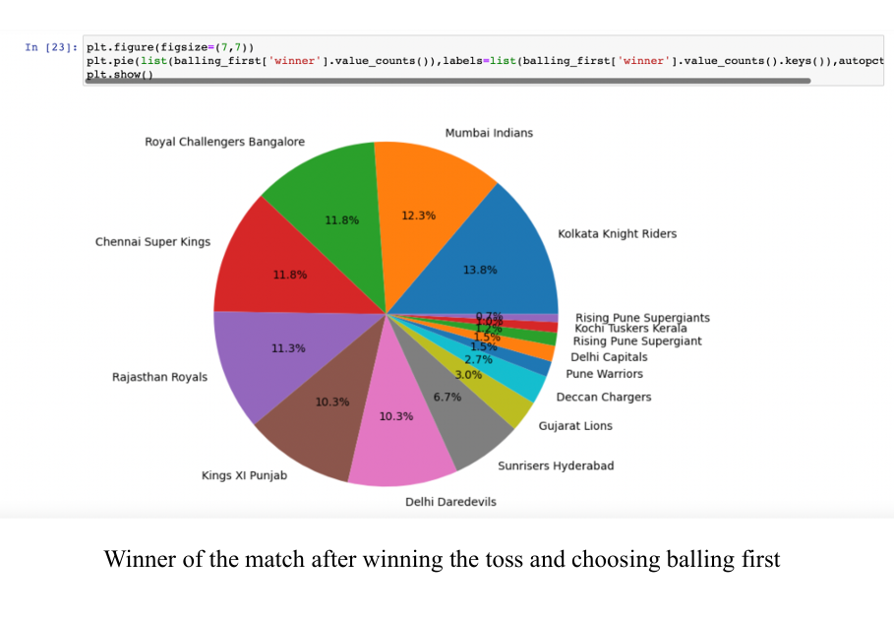

Slide 10
Project Link(GitHub, Google drive link)
https://github.com/Yadavanjali31/IPL-score-and-winner-prediction/upload/main

Slide 11
Conclusion
In The implementation of a web portal that can predict the target scores and winner of an IPL match using ML algorithms is a promising idea that can provide valuable insights and entertainment to cricket fans. Based on the performance of the model, it can be concluded that the predictions can be accurate to a certain extent.

Slide 12
Future scope
Personalized The future scope for this implementation could involve further fine-tuning of the ML algorithms used to make more accurate predictions. Additionally, including more variables such as weather, pitch conditions, player performance history, and team dynamics could further improve the accuracy of the predictions. Furthermore, this web portal can be expanded to cover other cricket leagues and tournaments globally, providing users with more opportunities to engage with the platform. Finally, the platform could be monetized by offering premium services to users, such as customized predictions and analytics based on user preferences and data.

Slide 13
References
Scikit-learn documentation: https://scikit-learn.org/stable/index.html
● Flask documentation: https://flask.palletsprojects.com/en/1.1.x/quickstart/
● Dataset links:
o ipl.csv:
https://drive.google.com/file/d/1nGYmbEB3GjJIuSF9lt5jrxlTxvf799eN/v
iew?usp=sharing
o matches.csv:
https://drive.google.com/file/d/1KFkurdApiH1OmyFx_2G0ABRHTtHRVHBw
/view?usp=sharing
● Python Documentation: https://www.python.org/doc

Slide 14
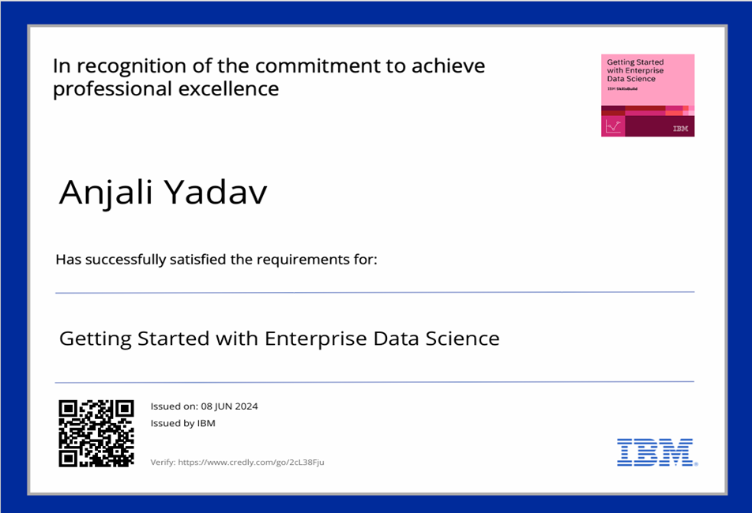
course certificate 1

Slide 15
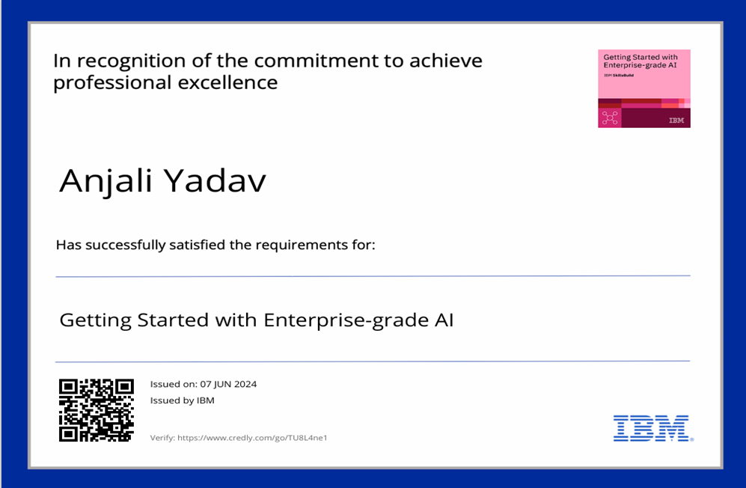
course certificate 2

Slide 16
THANK YOU

